Slide 1

By: shaun de ponte
AUGUST, 2025

Slide 2
About me
Software Engineer at BMW.
Co-Founder of Naughty Bean Coffee.
MSc in Business Analytics from Aston University.
I build things in my spare time.
Co-organiser for PyData Johannesburg.

Slide 3
What is a Tenant?

Slide 4
What is a tenant
A Tenant is the customer or user of the application, operating within their own isolated portion or instance of the software.

Slide 5
Types of tenant structures

Slide 6
types
Shared database with shared schema.
Shared database with isolated schema.
Isolated database with a shared app server.

Slide 7
DEMO
Using Django’s admin only

Slide 8
Jazzmin
Jazzmin, intended as a drop-in app to jazz up your Django Admin Site, with plenty of things you can easily customise, including a built-in UI customizer
Drop-in admin skin, all configuration optional
Select2 drop-downs
Bootstrap 4 & AdminLTE UI components
Search bar for any given model admin
Modal windows instead of popups
Customisable side menu
Customisable top menu
Customisable user menu
Responsive
Customisable UI (via Live UI changes, or custom CSS/JS)
Based on the latest adminlte + bootstrap

Slide 9
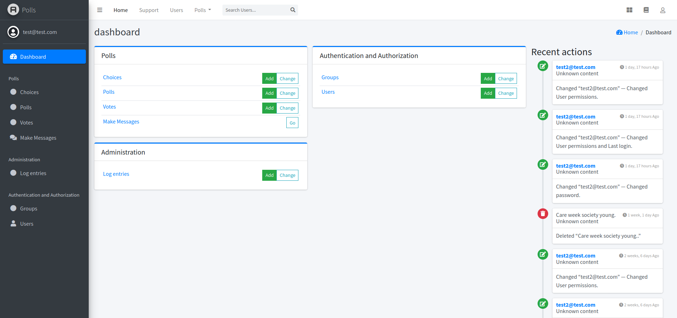
Jazzmin

Slide 10
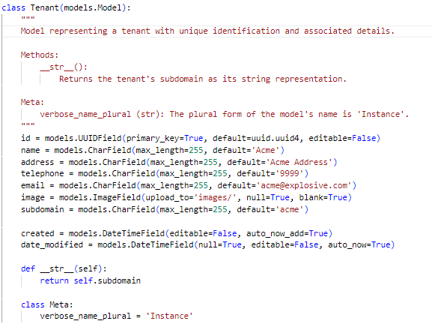
Tenant model
system_management > models.py

Slide 11
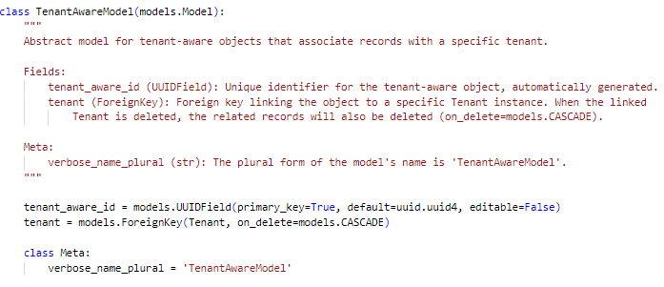
Tenant aware model
system_management > models.py

Slide 12
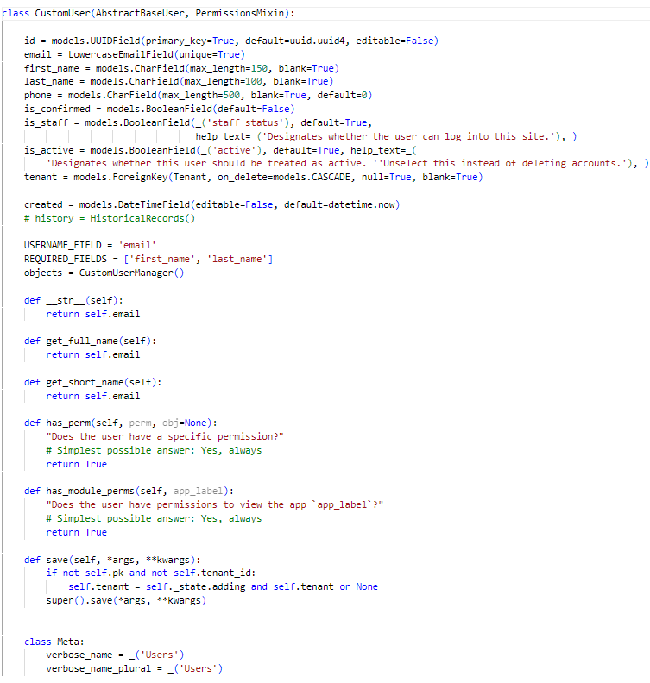
Custom user
system_management > models.py

Slide 13
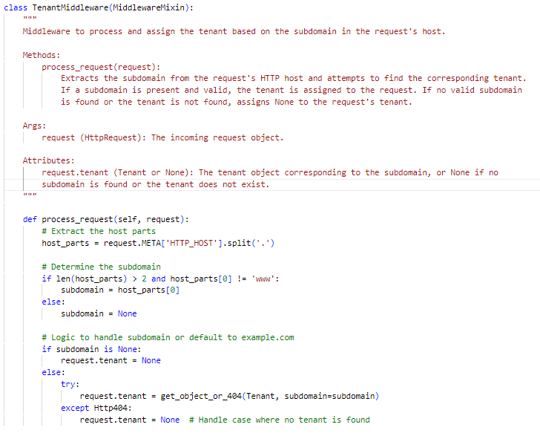
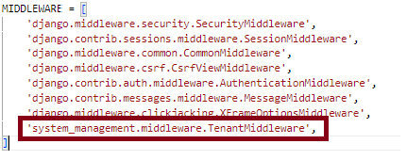
Middleware
system_management > middleware.py
settings.py

Slide 14
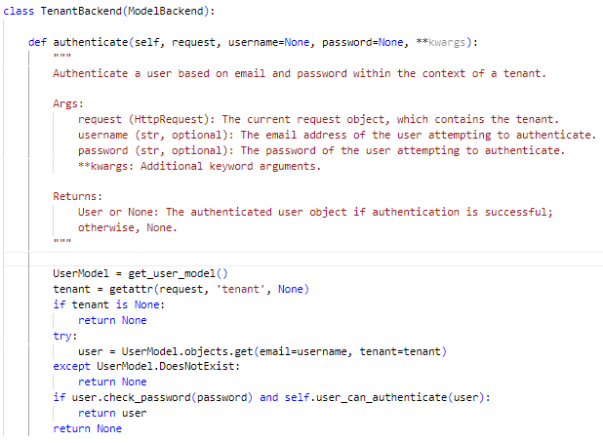
authentication
system_management > authentication.py

Slide 15
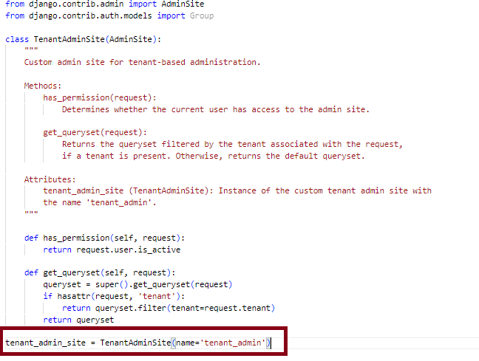
Custom admin site
system_management > custom_admin.py

Slide 16
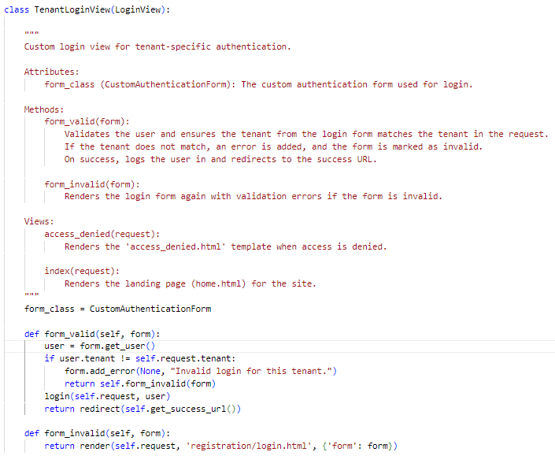
Views
system_management > views.py

Slide 17
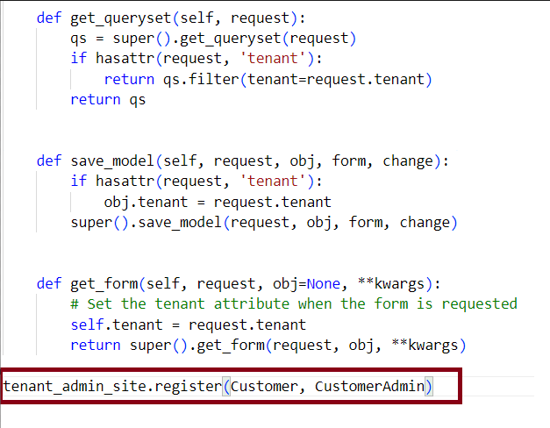
Register app model
system_management > admin.py

Slide 18
More Demo’s

Slide 19
Use cases

Slide 20
Use Cases
Quick proof of concept.
Building internal apps for your org.
Scalable into a robust multi-tenant app.
Database agnostic, easy to setup and deploy, no dependencies.

Slide 21
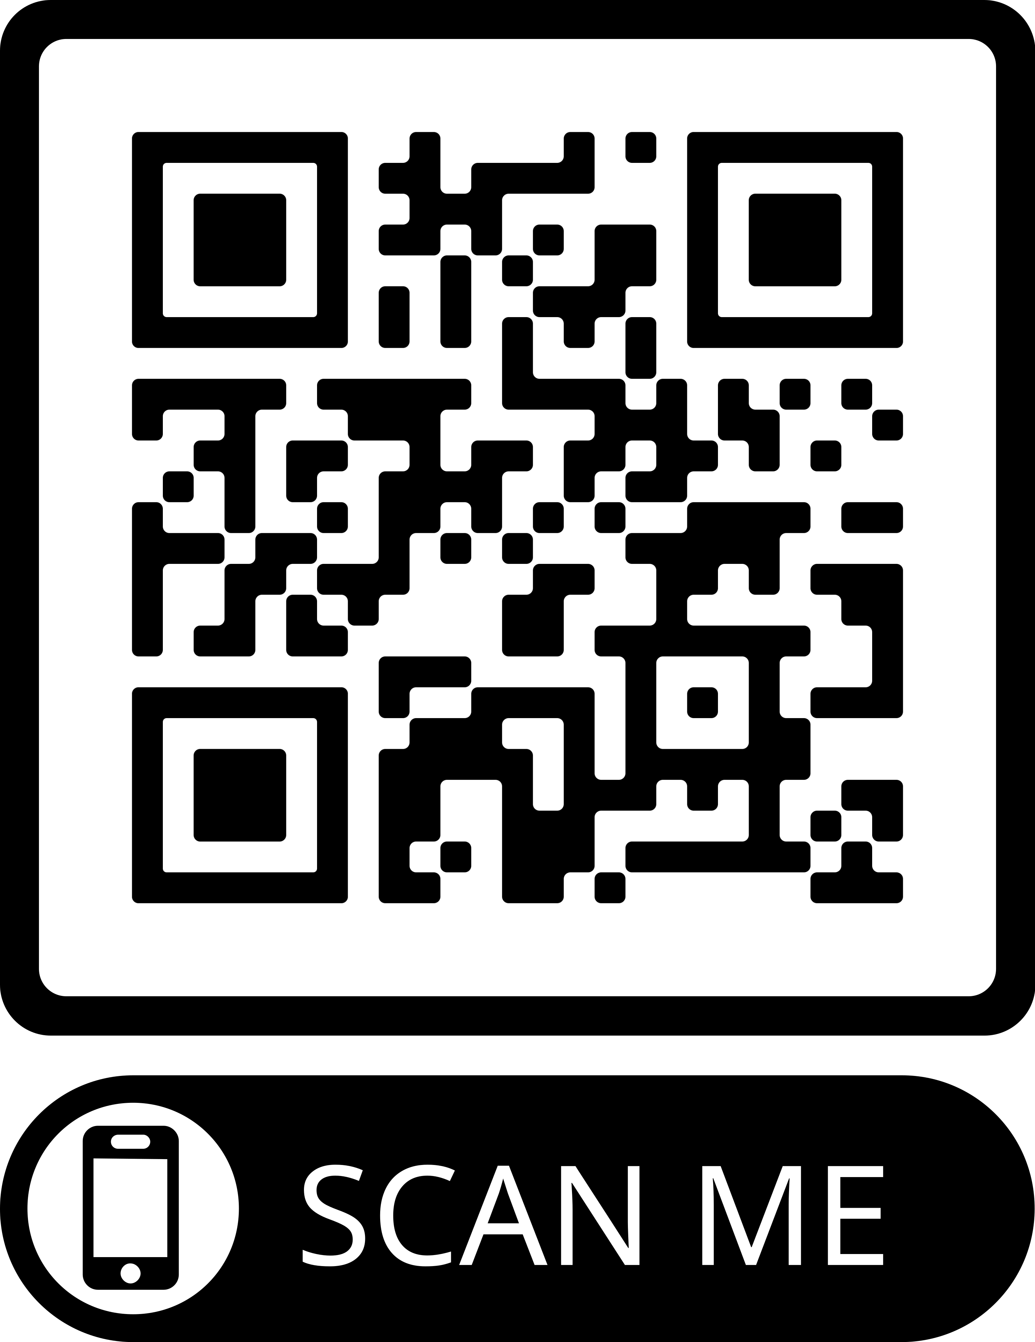
Thank You

